Slide 1


Basic Python
Python is a popular programming language. It was created by Guido van Rossum, and released in 1991.
It is used for:
Web development (server-side)
Software development
Mathematics
System scripting

Slide 2
Python Capabilities
Python can be used on a server to create web applications.
Python can be used alongside software to create workflows.
Python can connect to database systems. It can also read and modify files.
Python can be used to handle big data and perform complex mathematics.
Python can be used for rapid prototyping, or for production-ready software development.
Why Python?
Python works on different platforms (Windows, Mac, Linux,, etc). Raspberry Pi
Python has a simple syntax similar to the English language.
Python has syntax that allows developers to write programs with fewer lines than some other programming languages.
Python runs on an interpreter system, meaning that code can be executed as soon as it is written. This means that prototyping can be very quick.
Python can be treated in a procedural way, an object-orientated way or a functional way.

Slide 3
Python Syntax compared to other programming languages
Python was designed for readability, and has some similarities to the English language with influence from mathematics.
Python uses new lines to complete a command, as opposed to other programming languages which often use semicolons or parentheses.
Python relies on indentation, using whitespace, to define scope; such as the scope of loops, functions and classes. Other programming languages often use curly-brackets for this purpose.
Install Python
Use the link https://www.python.org/downloads/ to download python installer.

Slide 4
Python IDEs
IDLE (Integrated DeveLopment Environment or Integrated Development and Learning Environment)
Visual Studio Code
PyCharm
Sublime Text 3
Atom
Thonny
Vim
Spyder
Jupyter Notebook - open-source software that allows you to create and share live code, visualizations, etc.
The Basic Elements of Python
Objects, Expressions, and Numerical Types
Variables and Assignment
IDLE (Integrated Development Environment or Integrated Development and Learning Environment)

Slide 5
Objects, Expressions, and Numerical Types
Objects are the core things that Python programs manipulate. Every object has a type that defines the kinds of things that programs can do with objects of that type.
Types are either scalar or non-scalar.
Scalar objects
Scalar objects are indivisible i.e. they does not have internal structure.
Python has four types of scalar objects:
int is used to represent integers.
float is used to represent real numbers.
bool is used to represent the Boolean values True and False.
None is a type with a single value. None is just a value that commonly is used to signify 'empty', or 'no value here'.
Non-scalar objects have internal structure e.g. strings.

Slide 6
Logical Operators
Arithmetic Operator
Operator | Name | Example
+ | Addition | x + y
- | Subtraction | x - y
* | Multiplication | x * y
/ | Division | x / y
% | Modulus | x % y
** | Exponentiation | x ** y
// | Floor division | x // y
Operator | Name | Example
and | Returns True if both statements are true | x < 5 and x < 10
or | Returns True if one of the statements is true | x < 5 or x < 4
not | Reverse the result, returns False if the result is true | not(x < 5 and x < 10)
Identity Operators
Operator | Example | Same As
is | Returns True if both variables are the same object | x is y
is not | Returns True if both variables are not the same object | x is not y

Slide 7
Assignment Operator
Comparison Operators
Operator | Example | Same As
= | x = 5 | x = 5
+= | x += 3 | x = x + 3
-= | x -= 3 | x = x - 3
*= | x *= 3 | x = x * 3
/= | x /= 3 | x = x / 3
%= | x %= 3 | x = x % 3
//= | x //= 3 | x = x // 3
**= | x **= 3 | x = x ** 3
&= | x &= 3 | x = x & 3
|= | x |= 3 | x = x | 3
^= | x ^= 3 | x = x ^ 3
>>= | x >>= 3 | x = x >> 3
<<= | x <<= 3 | x = x << 3
Operator | Name | Example
== | Equal | x == y
!= | Not equal | x != y
> | Greater than | x > y
< | Less than | x < y
>= | Greater than or equal to | x >= y
<= | Less than or equal to | x <= y
Membership Operators
Operator | Example | Same As
in | Returns True if a sequence with the specified value is present in the object | x in y
not in | Returns True if a sequence with the specified value is not present in the object | x not in y

Slide 8
Bitwise Operators
Operator | Example | Same As
& | AND | Sets each bit to 1 if both bits are 1
| | OR | Sets each bit to 1 if one of two bits is 1
^ | XOR | Sets each bit to 1 if only one of two bits is 1
~ | NOT | Inverts all the bits
<< | Zero fill left shift | Shift left by pushing zeros in from the right and let the leftmost bits fall off
>> | Signed right shift | Shift right by pushing copies of the leftmost bit in from the left, and let the rightmost bits fall off
Type function (built in)
The built-in Python function type can be used to find out the type of an object.
Example:
type(3) – Output : <type 'int'>
type(3.0) – Output : <type 'float'>

Slide 9
Python Keywords
Python has a set of keywords that are reserved words that cannot be used as variable names, function names, or any other identifiers:
Keyword | Description
and | A logical operator
as | To create an alias
assert | For debugging
break | To break out of a loop
class | To define a class
continue | To continue to the next iteration of a loop
def | To define a function
del | To delete an object
elif | Used in conditional statements, same as else if
else | Used in conditional statements
except | Used with exceptions, what to do when an exception occurs
FALSE | Boolean value, result of comparison operations
finally | Used with exceptions, a block of code that will be executed no matter if there is an exception or not
for | To create a for loop
from | To import specific parts of a module

Slide 10
Keyword | Description
global | To declare a global variable
if | To make a conditional statement
import | To import a module
in | To check if a value is present in a list, tuple, etc.
is | To test if two variables are equal
lambda | To create an anonymous function
None | Represents a null value
nonlocal | To declare a non-local variable
not | A logical operator
or | A logical operator
pass | A null statement, a statement that will do nothing
raise | To raise an exception
return | To exit a function and return a value
TRUE | Boolean value, result of comparison operations
try | To make a try...except statement
while | To create a while loop
with | Used to simplify exception handling
yield | To end a function, returns a generator

Slide 11
Python allows multiple assignment
x, y = 2, 3 will assign 2 to x and 3 to y.
x, y = y, x will swap value of x and y.
IDLE
Integrated Development Environment or Integrated Development Learning Environment.
The IDE that comes as part of the standard Python installation package. IDLE is an application, just like any other application.
For detailed description, we can visit http://docs.python.org/library/idle.html

Slide 12
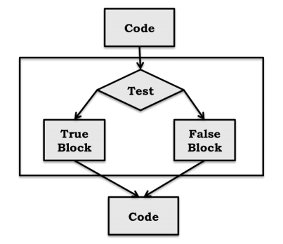

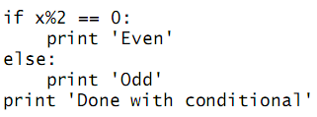
Conditional Statement (if..else)
If..else
In Python, a conditional statement has the form:
Example:

Slide 13
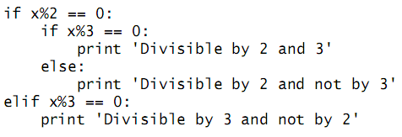
Indentation
Indentation is semantically meaningful in Python.
Leading whitespace (spaces and tabs) at the beginning of a logical line is used to compute the indentation level of the line, which in turn is used to determine the grouping of statements.
Most other programming languages use some sort of bracketing symbols to delineate blocks of code, e.g., C encloses blocks in braces, { }.
An advantage of the Python approach is that it ensures that the visual structure of a program is an accurate representation of the semantic structure of that program.
Example:

Slide 14


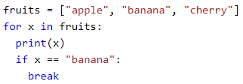
Looping Structure – For loop
A for loop is used for iterating over a sequence (that is either a list, a tuple, a dictionary, a set, or a string)
With the for loop we can execute a set of statements, once for each item in a list, tuple, set etc.
Print each fruit in a fruit list:
Loop through the letters in the word "banana":
Break statement - With the break statement we can stop the loop before it has looped through all the items:

Slide 15
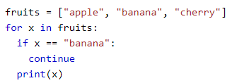


Continue Statement - With the continue statement we can stop the current iteration of the loop, and continue with the next iteration:
range() function - To loop through a set of code a specified number of times, we can use the range() function.
The range() function returns a sequence of numbers, starting from 0 by default, and increments by 1 (by default), and ends at a specified number.
Note that range(6) in above example, is not the values of 0 to 6, but the values 0 to 5.
The range() function defaults to 0 as a starting value, however it is possible to specify the starting value by adding a parameter: range(2, 6), which means values from 2 to 6 (but not including 6).

Slide 16

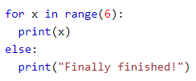
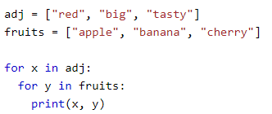
The range() function defaults to increment the sequence by 1, however it is possible to specify the increment value by adding a third parameter: range(2, 30, 3).
Else in For Loop – The else keyword in a for loop specifies a block of code to be executed when the loop is finished.
Nested Loop - A nested loop is a loop inside a loop. The "inner loop" will be executed one time for each iteration of the "outer loop":

Slide 17

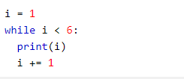
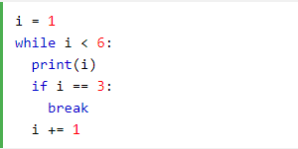
Looping Structure – While loop
The pass Statement – for loops cannot be empty, but if you for some reason have a for loop with no content, put in the pass statement to avoid getting an error.
With the while loop we can execute a set of statements as long as a condition is true.
With the break statement we can stop the loop even if the while condition is true.

Slide 18
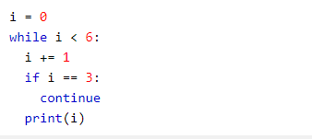
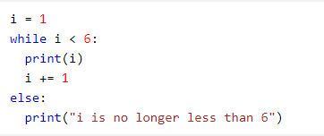

Python – Functions
With the continue statement we can stop the current iteration, and continue with the next.
With the else statement we can run a block of code once when the condition no longer is true
In Python a function is defined using the def keyword.

Slide 19
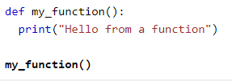
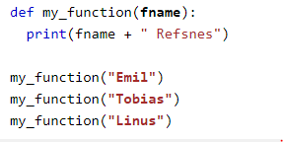
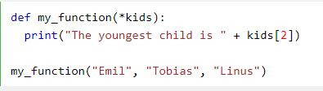
To call a function, use the function name followed by parenthesis.
Arguments are specified after the function name, inside the parentheses. You can add as many arguments as you want, just separate them with a comma
Arbitrary Arguments, *args : If you do not know how many arguments that will be passed into your function, add a * before the parameter name in the function definition. This way the function will receive a tuple of arguments and can access the item accordingly

Slide 20
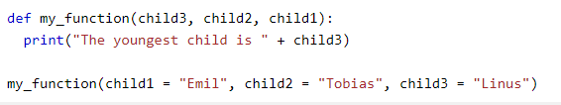

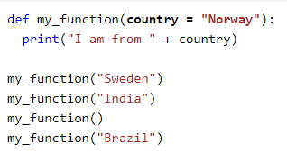
Keyword Arguments : You can also send arguments with the key = value syntax. This way the order of the arguments does not matter.
Arbitrary Keyword Arguments, **kwargs : If you do not know how many keyword arguments that will be passed into your function, add two asterisk(**) before the parameter name in the function definition. This way the function will receive a dictionary of arguments, and can access the items accordingly.
Default Parameter Value : The following example shows how to use a default parameter value. If we call the function without argument, it uses the default value.

Slide 21
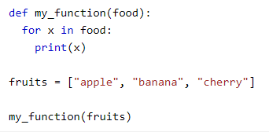
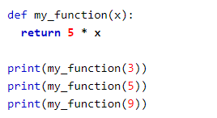

Passing a List as an Argument : You can send any data types of argument to a function (string, number, list, dictionary etc.), and it will be treated as the same data type inside the function. E.g. if you send a List as an argument, it will still be a List when it reaches the function.
Return Values: To let a function return a value, use the return statement: A function can return more than one values too.
The pass Statement: Function definition cannot be empty, but if you are for some reason have a function definition with no content, put in the pass statement to avoid getting an error.

Slide 22
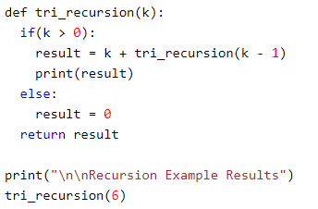
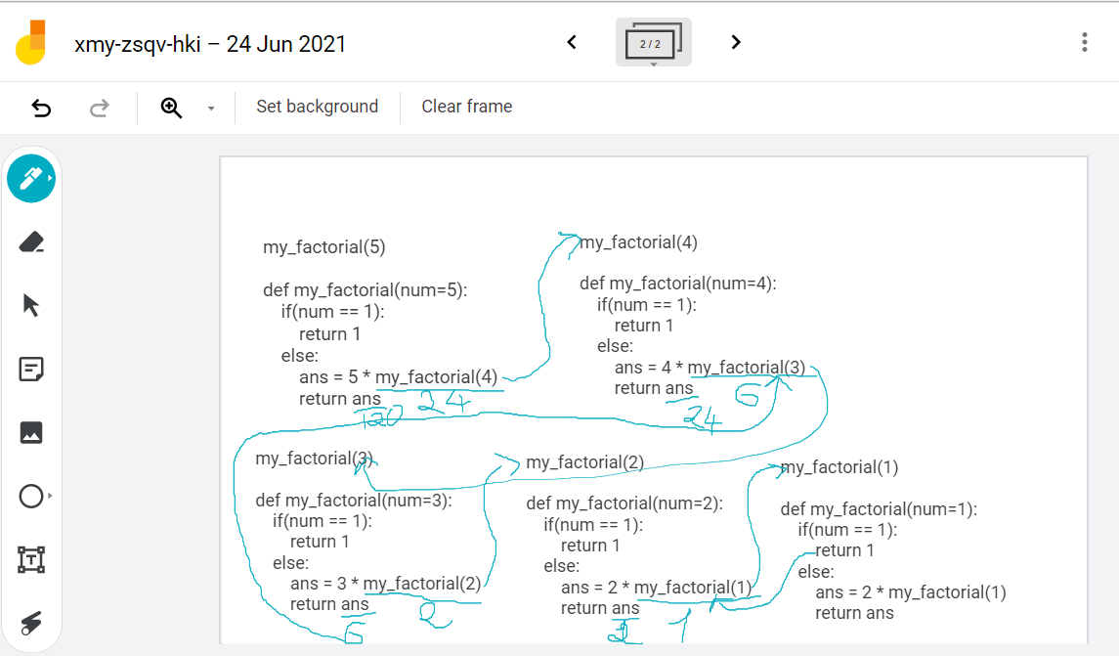
Understand recursive call of my_function(5)
Recursion: Python also accepts function recursion, which means a defined function can call itself. Recursion is a common mathematical and programming concept. It means that a function calls itself. This has the benefit of meaning that you can loop through data to reach a result

Slide 23



Python Collections (Arrays)
List is a collection which is ordered and changeable. Allows duplicate members. (Mutable)
Tuple is a collection which is ordered and unchangeable. Allows duplicate members. (Immutable)
Set is a collection which is unordered and unindexed. No duplicate members.
Dictionary is a collection which is unordered, changeable and indexed. No duplicate members.
List : A list is a collection which is ordered and changeable (Mutable). In Python, lists are written with square brackets.
Access Items: You access the list items by referring to the index number.
Negative Indexing: Negative indexing means beginning from the end, -1 refers to the last item, -2 refers to the second last item etc.

Slide 24




Range of Indexes: You can specify a range of indexes by specifying where to start and where to end the range. When specifying a range, the return value will be a new list with the specified items.
Loop Through a List: You can loop through the list items by using a for loop:
Check if Item Exists : To determine if a specified item is present in a list using the “in” operator.
List Length : To determine how many items a list has, use the len() function:
Add Items: To add an item to the end of the list, use the append() function:

Slide 25





Remove Item : There are several methods to remove items from a list.
The remove() method removes the specified item:
The pop() method removes the specified index or the last item if index is not specified.
The del keyword can also delete the list completely:
The del keyword removes the specified index:
The clear() method empties the list:

Slide 26


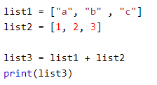
Copy a List: You cannot copy a list simply by typing list2 = list1, because: list2 will only be a reference to list1, and changes made in list1 will automatically also be made in list2. There are ways to make a copy, one way is to use the built-in List method copy().
Another way to make a copy is to use the built-in method list().
Join Two Lists : There are several ways to join, or concatenate, two or more lists in Python.

Slide 27
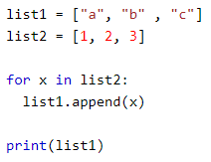
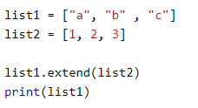
Another way to join two lists are by appending all the items from list2 into list1, one by one.
You can use the extend() method, which purpose is to add elements from one list to another list.
The list() Constructor: It is also possible to use the list() constructor to make a new list.

Slide 28
Method | Description
append() | Adds an element at the end of the list
clear() | Removes all the elements from the list
copy() | Returns a copy of the list
count() | Returns the number of elements with the specified value
extend() | Add the elements of a list (or any iterable), to the end of the current list
index() | Returns the index of the first element with the specified value
insert() | Adds an element at the specified position
pop() | Removes the element at the specified position
remove() | Removes the item with the specified value
reverse() | Reverses the order of the list
sort() | Sorts the list

Slide 29



Tuple
A tuple is a collection which is ordered and unchangeable (Immutable). In Python tuples are written with round brackets.
Access Tuple Items - You can access tuple items by referring to the index number, inside square brackets:
Negative Indexing - Negative indexing means beginning from the end, -1 refers to the last item, -2 refers to the second last item etc.
Range of Indexes - You can specify a range of indexes by specifying where to start and where to end the range. When specifying a range, the return value will be a new tuple with the specified items.

Slide 30
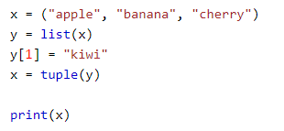



Change Tuple Values - Once a tuple is created, you cannot change its values. Tuples are unchangeable, or immutable as it also is called. But there is a workaround. You can convert the tuple into a list, change the list, and convert the list back into a tuple.
Loop Through a Tuple - You can loop through the tuple items by using a for loop.
Check if Item Exists - To determine if a specified item is present in a tuple use the in keyword:
Tuple Length - To determine how many items a tuple has, use the len() method:

Slide 31
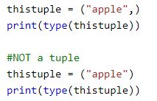
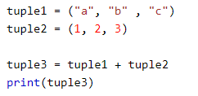
Add Items - Once a tuple is created, you cannot add items to it. Tuples are unchangeable.
Remove Items - Tuples are unchangeable, so you cannot remove items from it, but you can delete the tuple completely:
del thistupple
Create Tuple With One Item - To create a tuple with only one item, you have to add a comma after the item, otherwise Python will not recognize it as a tuple.
Join Two Tuples - To join two or more tuples you can use the + operator:

Slide 32


Set
The tuple() Constructor - It is also possible to use the tuple() constructor to make a tuple.
count() - Returns the number of times a specified value occurs in a tuple.
index() - Searches the tuple for a specified value and returns the position of where it was found
A set is a collection which is unordered and unindexed. In Python sets are written with curly brackets. Sets are unordered, so you cannot be sure in which order the items will appear. No duplicate members.
Access Items - You cannot access items in a set by referring to an index, since sets are unordered the items has no index. But you can loop through the set items using a for loop, or ask if a specified value is present in a set, by using the in keyword.

Slide 33
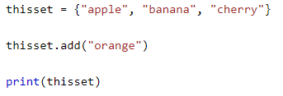
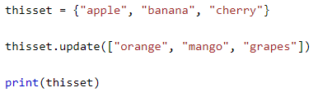

Change Items - Once a set is created, you cannot change its items, but you can add new items.
Add Items - To add one item to a set use the add() method. To add more than one item to a set use the update() method.
Add multiple items to a set, using the update() method:
Get the Length of a Set - To determine how many items a set has, use the len() method.

Slide 34
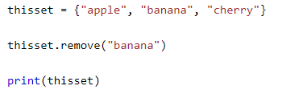
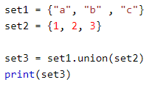
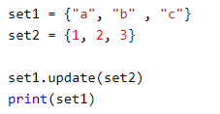
Remove Item - To remove an item in a set, use the remove(), or the discard() method. If the item to remove does not exist, remove() will raise an error. If the item to remove does not exist, discard() will NOT raise an error.
You can also use the pop(), method to remove an item, but this method will remove the last item. Remember that sets are unordered, so you will not know what item that gets removed.
The clear() method empties the set.
The del keyword will delete the set completely.
Join Two Sets - There are several ways to join two or more sets in Python.
You can use the union() method that returns a new set containing all items from both sets, or the update() method that inserts all the items from one set into another:
The update() method inserts the items in set2 into set1:
Both union() and update() will exclude any duplicate items.

Slide 35
The set() Constructor - It is also possible to use the set() constructor to make a set.

Slide 36
Method | Description
add() | Adds an element to the set
clear() | Removes all the elements from the set
copy() | Returns a copy of the set
difference() | Returns a set containing the difference between two or more sets
difference_update() | Removes the items in this set that are also included in another, specified set
discard() | Remove the specified item
intersection() | Returns a set, that is the intersection of two other sets
intersection_update() | Removes the items in this set that are not present in other, specified set(s)
isdisjoint() | Returns whether two sets have a intersection or not
issubset() | Returns whether another set contains this set or not
issuperset() | Returns whether this set contains another set or not
pop() | Removes an element from the set
remove() | Removes the specified element
symmetric_difference() | Returns a set with the symmetric differences of two sets
symmetric_difference_update() | inserts the symmetric differences from this set and another
union() | Return a set containing the union of sets
update() | Update the set with the union of this set and others

Slide 37
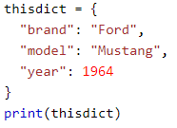
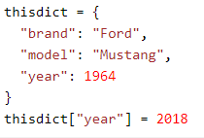

Dictionary
A dictionary is a collection which is unordered, changeable (mutable) and indexed. In Python dictionaries are written with curly brackets, and they have keys and values.
Accessing Items - You can access the items of a dictionary by referring to its key name, inside square brackets:
Change Values - You can change the value of a specific item by referring to its key name
Loop Through a Dictionary - You can loop through a dictionary by using a for loop. When looping through a dictionary, the return value are the keys of the dictionary, but there are methods to return the values as well.

Slide 38



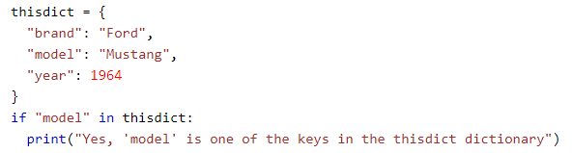
Print all values in the dictionary, one by one:
You can also use the values() method to return values of a dictionary:
Loop through both keys and values, by using the items() method:
Check if Key Exists - To determine if a specified key is present in a dictionary use the in keyword:
Dictionary Length - To determine how many items (key-value pairs) a dictionary has, use the len() function.

Slide 39
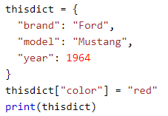
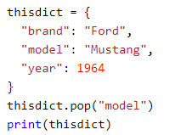
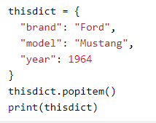
Adding Items - Adding an item to the dictionary is done by using a new index key and assigning a value to it
Removing Items - There are several methods to remove items from a dictionary:
The popitem() method removes the last inserted item.

Slide 40
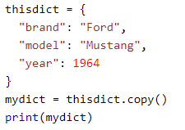
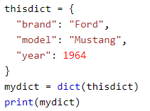
The del keyword removes the item with the specified key name:
The del keyword can also delete the dictionary completely:
The clear() method empties the dictionary:
Copy a Dictionary - You cannot copy a dictionary simply by typing dict2 = dict1, because: dict2 will only be a reference to dict1, and changes made in dict1 will automatically also be made in dict2. There are ways to make a copy, one way is to use the built-in Dictionary method copy().
Another way to make a copy is to use the built-in function dict().

Slide 41
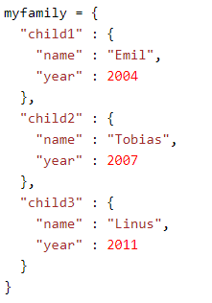
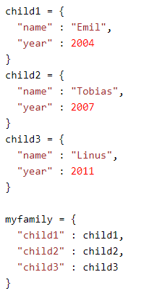

Nested Dictionaries - A dictionary can also contain many dictionaries, this is called nested dictionaries.
Or, if you want to nest three dictionaries that already exists as dictionaries:
The dict() Constructor - It is also possible to use the dict() constructor
to make a new dictionary:

Slide 42


Python Classes and Objects
Python is an object oriented programming language.
Almost everything in Python is an object, with its properties and methods.
A Class is like an object constructor, or a "blueprint" for creating objects.
To create a class, use the keyword class.
we can use the class named MyClass to create objects.
The __init__() Function - Constructor
All classes have a function called __init__(), which is always executed when the class is being initiated.
The __init__() function is called automatically every time the class is being used to create a new object.
Use the __init__() function to assign values to object properties, or other operations that are necessary to do when the object is being created.

Slide 43
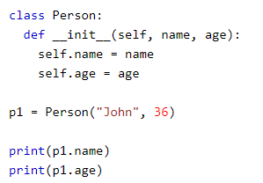
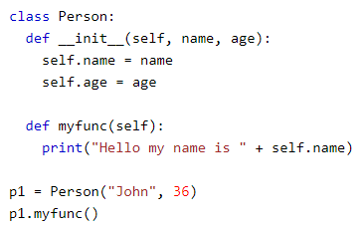
Object Methods
Objects can also contain methods. Methods in objects are functions that belong to the object.
The self parameter is a reference to the current instance of the class, and is used to access variables that belong to the class.

Slide 44
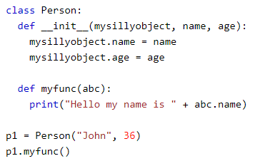


The self Parameter
The self parameter is a reference to the current instance of the class, and is used to access variables that belongs to the class.
It does not have to be named self , you can call it whatever you like, but it has to be the first parameter of any function in the class.
Modify Object Properties.
Delete Object Properties.

Slide 45

Python Inheritance
Delete Objects.
The pass Statement
class definitions cannot be empty, but if you for some reason have a class definition with no content, put in the pass statement to avoid getting an error
Inheritance allows us to define a class that inherits all the methods and properties from another class.
Parent class is the class being inherited from, also called base class.
Child class is the class that inherits from another class, also called derived class.
Single Inheritance:
Single inheritance enables a derived class to inherit properties from a single parent class, thus enabling code reusability and addition of new features to existing code.

Slide 46
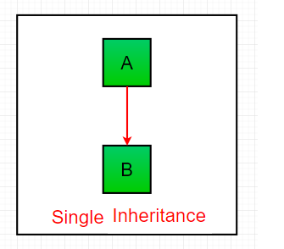
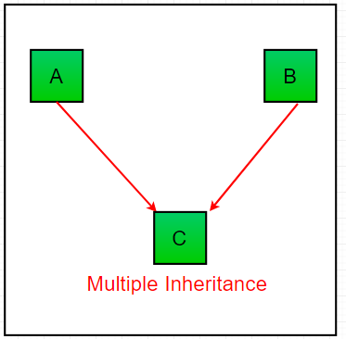
Multiple Inheritance:
When a class can be derived from more than one base classes this type of inheritance is called multiple inheritance. In multiple inheritance, all the features of the base classes are inherited into the derived class.
Multilevel Inheritance
In multilevel inheritance, features of the base class and the derived class are further inherited into the new derived class. This is similar to a relationship representing a child and grandfather.

Slide 47
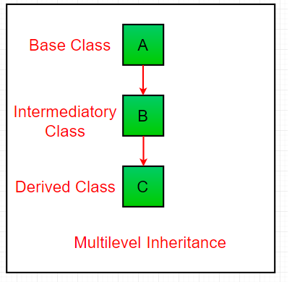
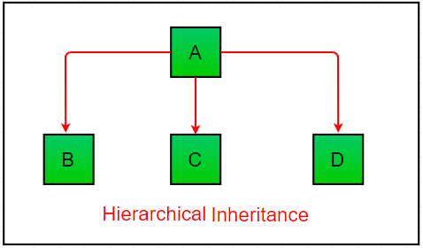
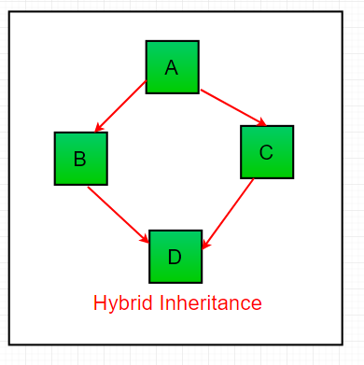
Hierarchical Inheritance:
When more than one derived classes are created from a single base this type of inheritance is called hierarchical inheritance. In this program, we have a parent (base) class and two child (derived) classes.
Hybrid Inheritance:
Inheritance consisting of multiple types of inheritance is called hybrid inheritance.

Slide 48
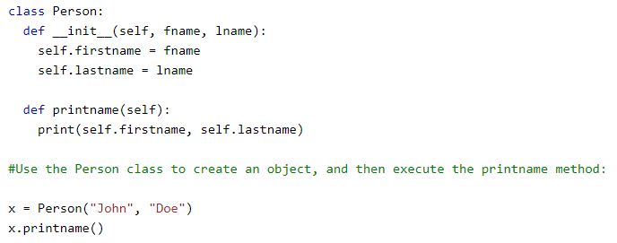



Create a Parent Class
Create a Child Class
Now the Student class has the same properties and methods as the Person class.
Override __init__().

Slide 49



Python Try Except
Use the super() Function - Python also has a super() function that will make the child class inherit all the methods and properties from its parent.
By using the super() function, you do not have to use the name of the parent element, it will automatically inherit the methods and properties from its parent.
The try block lets you test a block of code for errors.
The except block lets you handle the error.
The finally block lets you execute code, regardless of the result of the try- and except blocks.
When an error occurs, or exception as we call it, Python will normally stop and generate an error message.
These exceptions can be handled using the try statement.
Many Exceptions: You can define as many exception blocks as you want, e.g. if you want to execute a special block of code for a special kind of error.

Slide 50




Else - You can use the else keyword to define a block of code to be executed if no errors were raised.
Finally - The finally block, if specified, will be executed regardless if the try block raises an error or not.
Raise an exception - As a Python developer you can choose to throw an exception if a condition occurs. To throw
(or raise) an exception, use the raise keyword.
The raise keyword is used to raise an exception. You can define what kind of error to raise, and the text to print to the
user.
https://docs.python.org/3/library/exceptions.html

Slide 51





Python Modules
Consider a module to be the same as a code library.
A file containing a set of functions, variables, collections(list, tuple, set, dictionary etc) you want to include in your application.
To create a module just save the code you want in a file with the file extension .py
Use a Module - Now we can use the module we just created, by using the import statement.
Variables in Module - The module can contain functions, as already described, but also variables of all types (arrays, dictionaries, objects etc)
Re-naming a Module - You can create an alias when you import a module, by using the as keyword.

Slide 52



Python assert Keyword
Built-in Modules - There are several built-in modules in Python, which you can import whenever you like.
Import From Module - You can choose to import only parts from a module, by using the from keyword.
The assert keyword is used when debugging code.
The assert keyword lets you test if a condition in your code returns True, if not, the program will raise an AssertionError.
You can write a message to be written if the code returns False.

Slide 53
File Handling
The key function for working with files in Python is the open() function.
There are four different methods (modes) for opening a file.
"r" - Read - Default value. Opens a file for reading, error if the file does not exist
"a" - Append - Opens a file for appending, creates the file if it does not exist
"w" - Write - Opens a file for writing, creates the file if it does not exist
"x" - Create - Creates the specified file, returns an error if the file exists
In addition you can specify if the file should be handled as binary or text mode
"t" - Text - Default value. Text mode
"b" - Binary - Binary mode (e.g. images)

Slide 54
Access Modes | Description
r | Opens a file for reading only. Start reading from the beginning of the file and is the default mode for the open()
rb | Opens a file for reading only in binary format. Start reading from the beginning of the file. Binary mode can be used to deal with files like images, videos…etc.
r+ | Opens a file for both reading and writing. Placing the pointer at the beginning of the file.
rb+ | Opens a file for both reading and writing in binary format. Placing the pointer at the beginning of the file.
w | Opens a file for writing only. The pointer is placed at the beginning of the file and will overwrite any existing file with the same name. It will create a new file if the same name does not exists.
wb | Opens a file for writing only in binary format.
w+ | Opens a file for both writing and reading.
wb+ | Opens a file for both writing and reading in binary format.
a | Opens a file for appending. The pointer is placed at the end of the file. A new file is created if one with the same name does not exists.
ab | Opens a file for appending in binary format.
a+ | Opens a file for both appending and reading.
ab+ | Opens a file for both appending and reading in binary format.

Slide 55





To open the file, use the built-in open() function.
The open() function returns a file object, which has a read() method for reading the content of the file.
Read Only Parts of the File - By default the read() method returns the whole text, but you can also specify how many characters you want to return.
Read Lines - You can return one line by using the readline() method.
By looping through the lines of the file, you can read the whole file, line by line
Close Files - It is a good practice to always close the file when you are done with it.
You should always close your files, in some cases, due to buffering, changes made to a file may not show until you close the file.

Slide 56




Write to an Existing File - To write to an existing file, you must add a parameter to the open() function.
Open the file "demofile3.txt" and overwrite the content. The "w" method will overwrite the entire file.
Create a New File - To create a new file in Python, use the open() method, with one of the following parameters.
"x" - Create - will create a file, returns an error if the file exist.
"a" - Append - will create a file if the specified file does not exist
"w" - Write - will create a file if the specified file does not exist
Delete a File - To delete a file, you must import the OS module, and run its os.remove() function.
Check if File exist - To avoid getting an error, you might want to check if the file exists before you try to delete it.

Slide 57



Python Scope
“w” mode | “a” mode | “x” mode
Open file for writing | Open file for appending | Open file for writing
If file exists – Overwrite | If file exists – Append | If file exists – Error
If file does not exists – Create | If file does not exists – Create | If file does not exists – Create
Place file pointer at the top of file. | Place file pointer at the end of file. | Place file pointer at the top of file.
Delete Folder - To delete an entire folder, use the os.rmdir() method. You can only remove empty folders.
Learn all functions of os module.
A variable is only available from inside the region it is created. This is called scope.
Local Scope - A variable created inside a function belongs to the local scope of that function, and can only be used inside that function.
Function Inside Function - As explained in the example above, the variable x is not available outside the function, but it is available for any function inside the function.

Slide 58




Global Scope - A variable created in the main body of the Python code is a global variable and belongs to the global scope. Global variables are available from within any scope, global and local.
Naming Variables - If you operate with the same variable name inside and outside of a function, Python will treat them as two separate variables, one available in the global scope (outside the function) and one available in the local scope (inside the function)
Global Keyword - If you need to create a global variable, but are stuck in the local scope, you can use the global keyword. The global keyword makes the variable global.
Also, use the global keyword if you want to make a change to a global variable inside a function. To change the value of a global variable inside a function, refer to the variable by using the global keyword

Slide 59

Linear Search
Start from the leftmost element of arr[] and one by one compare x with each element of arr[]
If x matches with an element, return the index.
If x doesn’t match with any of elements, return -1.
# Python3 code to linearly search x in arr[]. If x is present then return its location, otherwise return -1
def search(arr, n, x):
for i in range (0, n):
if (arr[i] == x):
return i;
return -1;
arr = [ 2, 3, 4, 10, 40 ];
x = 10;
n = len(arr);
result = search(arr, n, x)
if(result == -1):
print("Element is not present in array")
else:
print("Element is present at index", result);

Slide 60

Binary Search
Binary Search: Search a sorted array by repeatedly dividing the search interval in half. Begin with an interval covering the whole array. If the value of the search key is less than the item in the middle of the interval, narrow the interval to the lower half. Otherwise narrow it to the upper half. Repeatedly check until the value is found or the interval is empty.

Slide 61
# Python3 Program for recursive binary search, Returns index of x in arr if present, else -1
def binarySearch (arr, l, r, x):
# Check base case
if r >= l:
mid = l + (r - l) // 2
# If element is present at the middle itself
if arr[mid] == x:
return mid
# If element is smaller than mid, then it can only be present in left subarray
elif arr[mid] > x:
return binarySearch(arr, l, mid-1, x)
# Else the element can only be present in right subarray
else:
return binarySearch(arr, mid + 1, r, x)
else:
return -1 # Element is not present in the array
# Driver Code
arr = [ 2, 3, 4, 10, 40 ]
x = 10
# Function call
result = binarySearch(arr, 0, len(arr)-1, x)
if result != -1:
print ("Element is present at index % d" % result)
else:
print ("Element is not present in array")

Slide 62

Selection Sort
In selection sort we start by finding the minimum value in a given list and move it to a sorted list. Then we repeat the process for each of the remaining elements in the unsorted list. The next element entering the sorted list is compared with the existing elements and placed at its correct position. So at the end all the elements from the unsorted list are sorted.

Slide 63
def selectionSort(array, size):
for step in range(size):
min_idx = step
for i in range(step + 1, size):
# to sort in descending order, change > to < in this line
# select the minimum element in each loop
if array[i] < array[min_idx]:
min_idx = i
# put min at the correct position
(array[step], array[min_idx]) = (array[min_idx], array[step])
data = [-2, 45, 0, 11, -9]
size = len(data)
selectionSort(data, size)
print('Sorted Array in Ascending Order:')
print(data)

Slide 64

Bubble Sort
It is a comparison-based algorithm in which each pair of adjacent elements is compared and the elements are swapped if they are not in order.
def bubblesort(list): # Swap the elements to arrange in order
for step in range(len(list)-1,0,-1):
for idx in range(step):
if list[idx]>list[idx+1]:
list[idx],list[idx+1] = list[idx+1], list[idx]
list = [19,2,31,5,100,456,212,45,6,11]
bubblesort(list)
print(list)

Slide 65

Merge Sort
Merge sort first divides the array into equal halves and then combines them in a sorted manner.
def merge_sort(unsorted_list):
if len(unsorted_list) <= 1:
return unsorted_list
# Find the middle point and devide it
middle = len(unsorted_list) // 2
left_list = unsorted_list[:middle]
right_list = unsorted_list[middle:]
left_list = merge_sort(left_list)
right_list = merge_sort(right_list)
return list(merge(left_list, right_list))
# Merge the sorted halves
def merge(left_half,right_half):
res = []
while len(left_half) != 0 and len(right_half) != 0:
if left_half[0] < right_half[0]:
res.append(left_half[0])
left_half.remove(left_half[0])
else:
res.append(right_half[0])
right_half.remove(right_half[0])
if len(left_half) == 0:
res = res + right_half
else:
res = res + left_half
return res
unsorted_list = [64, 34, 25, 12, 22, 11, 90]
print(merge_sort(unsorted_list))

Slide 66

Insertion sort
Insertion sort is a simple sorting algorithm that works similar to the way you sort playing cards in your hands. The array is virtually split into a sorted and an unsorted part. Values from the unsorted part are picked and placed at the correct position in the sorted part.
Algorithm To sort an array of size n in ascending order: 1: Iterate from arr[0] to arr[n] over the array. 2: Compare the current element (key) to its predecessor. 3: If the key element is smaller than its predecessor, compare it to the elements before. Move the greater elements one position up to make space for the swapped element.

Slide 67
# Python program for implementation of Insertion Sort
# Function to do insertion sort
def insertionSort(arr):
# Traverse through 1 to len(arr)
for i in range(1, len(arr)):
key = arr[i]
# Move elements of arr[0..i-1], that are
# greater than key, to one position ahead
# of their current position
j = i-1
while j >= 0 and key < arr[j] :
arr[j + 1] = arr[j]
j -= 1
arr[j + 1] = key
# Driver code to test above
arr = [12, 11, 13, 5, 6]
insertionSort(arr)
for i in range(len(arr)):
print ("% d" % arr[i])

Slide 68
Shell Sort
ShellSort is mainly a variation of Insertion Sort. In insertion sort, we move elements only one position ahead. When an element has to be moved far ahead, many movements are involved. The idea of shellSort is to allow exchange of far items. In shellSort, we make the array h-sorted for a large value of h. We keep reducing the value of h until it becomes 1. An array is said to be h-sorted if all sublists of every h’th element is sorted.
In this sorting algorithm we compare elements that are a distance aprt rather than adjacent.
We calculate “gap” for each pass, and then select the elements towards the right gap.
In this case we reduce the gap by dividing it by 2.
Quick Sort
Like Merge Sort, QuickSort is a Divide and Conquer algorithm. It picks an element as pivot and partitions the given array around the picked pivot. There are many different versions of quickSort that pick pivot in different ways.
Always pick first element as pivot.
Always pick last element as pivot
Pick a random element as pivot.
Pick median as pivot.
The key process in quickSort is partition(). Target of partitions is, given an array and an element x of array as pivot, put x at its correct position in sorted array and put all smaller elements (smaller than x) before x, and put all greater elements (greater than x) after x. All this should be done in linear time.

Slide 69

Hashtables
Hash tables are a type of data structure in which the address or the index value of the data element is generated from a hash function. That makes accessing the data faster as the index value behaves as a key for the data value. In other words Hash table stores key-value pairs but the key is generated through a hashing function.
So the search and insertion function of a data element becomes much faster as the key values themselves become the index of the array which stores the data.
In Python, the Dictionary data types represent the implementation of hash tables. The Keys in the dictionary satisfy the following requirements.
The keys of the dictionary are hashable i.e. the are generated by hashing function which generates unique result for each unique value supplied to the hash function.
The order of data elements in a dictionary is not fixed.

Slide 70
Regular Expression
Character | Description | Example
[] | A set of characters | "[a-m]"
\ | Signals a special sequence (can also be used to escape special characters) | "\d"
. | Any character (except newline character) | "he..o"
^ | Starts with | "^hello"
$ | Ends with | "world$"
* | Zero or more occurrences | "aix*"
+ | One or more occurrences | "aix+"
{} | Exactly the specified number of occurrences | "al{2}"
| | Either or | "falls|stays"

Slide 71
Special Sequences
Character | Description | Example
\A | Returns a match if the specified characters are at the beginning of the string | "\AThe"
\b | Returns a match where the specified characters are at the beginning or at the end of a word (the "r" in the beginning is making sure that the string is being treated as a "raw string") | r"\bain" r"ain\b"
\B | Returns a match where the specified characters are present, but NOT at the beginning (or at the end) of a word (the "r" in the beginning is making sure that the string is being treated as a "raw string") | r"\Bain" r"ain\B"
\d | Returns a match where the string contains digits (numbers from 0-9) | "\d"
\D | Returns a match where the string DOES NOT contain digits | "\D"
\s | Returns a match where the string contains a white space character | "\s"
\S | Returns a match where the string DOES NOT contain a white space character | "\S"
\w | Returns a match where the string contains any word characters (characters from a to Z, digits from 0-9, and the underscore _ character) | "\w"
\W | Returns a match where the string DOES NOT contain any word characters | "\W"
\Z | Returns a match if the specified characters are at the end of the string | "Spain\Z"

Slide 72
Set | Description
[arn] | Returns a match where one of the specified characters (a, r, or n) are present
[a-n] | Returns a match for any lower case character, alphabetically between a and n
[^arn] | Returns a match for any character EXCEPT a, r, and n
[0123] | Returns a match where any of the specified digits (0, 1, 2, or 3) are present
[0-9] | Returns a match for any digit between 0 and 9
[0-5][0-9] | Returns a match for any two-digit numbers from 00 and 59
[a-zA-Z] | Returns a match for any character alphabetically between a and z, lower case OR upper case
[+] | In sets, +, *, ., |, (), $,{} has no special meaning, so [+] means: return a match for any + character in the string

Slide 73
The findall() function returns a list containing all matches.
The list contains the matches in the order they are found.
If no matches are found, an empty list is returned.
The search() function searches the string for a match, and returns a Match object if there is a match.
If there is more than one match, only the first occurrence of the match will be returned.
If no matches are found, the value None is returned.
The split() function returns a list where the string has been split at each match.
You can control the number of occurrences by specifying the maxsplit parameter.
The sub() function replaces the matches with the text of your choice.
You can control the number of replacements by specifying the count parameter.
Compile
We can combine a regular expression pattern into pattern objects, which can be used for pattern matching. It also helps to search a pattern again without rewriting it.
re.compile(pattern, flags=0)

Slide 74
JSON
The full-form of JSON is JavaScript Object Notation. It means that a script (executable) file which is made of text in a programming language, is used to store and transfer the data. Python supports JSON through a built-in package called json. To use this feature, we import the json package in Python script. The text in JSON is done through quoted string which contains the value in key-value mapping within { }. It is similar to the dictionary in Python.
Serializing JSON refers to the transformation of data into a series of bytes (hence serial) to be stored or transmitted across a network. To handle the data flow in a file, the JSON library in Python uses dump() or dumps() function to convert the Python objects into their respective JSON object, so it makes easy to write data to files. See the following table given below.
PYTHON OBJECT | JSON OBJECT
dict | object
list, tuple | array
str | string
int, long, float | numbers
True | true
False | false
None | null

Slide 75
Using json.dumps() - The JSON package in python has a function called json.dumps() that helps in converting a dictionary to a JSON object.
It takes two parameters:
dictionary – name of dictionary which should be converted to JSON object.
indent – defines the number of units for indentation
# Python program to write JSON to a file
import json
# Data to be written
dictionary ={
"name" : "sathiyajith",
"rollno" : 56,
"cgpa" : 8.6,
"phonenumber" : "9976770500"
}
# Serializing json
json_object = json.dumps(dictionary, indent = 4)
# Writing to sample.json
with open("sample.json", "w") as outfile:
outfile.write(json_object)

Slide 76
Using json.dump() - Another way of writing JSON to a file is by using json.dump() method. The JSON package has the “dump” function which directly writes the dictionary to a file in the form of JSON, without needing to convert it into an actual JSON object.
# Python program to write JSON to a file
import json
# Data to be written
dictionary ={
"name" : "sathiyajith",
"rollno" : 56,
"cgpa" : 8.6,
"phonenumber" : "9976770500"
}
with open("sample.json", "w") as outfile:
json.dump(dictionary, outfile)

Slide 77
Reading JSON from a file using python - Deserialization is the opposite of Serialization, i.e. conversion of JSON object into their respective Python objects. The load() method is used for it. If you have used JSON data from another program or obtained as a string format of JSON, then it can easily be deserialized with load(), which is usually used to load from string, otherwise, the root object is in list or dict.
Using json.load() - The JSON package has json.load() function that loads the json content from a json file into a dictionary.
# Python program to read JSON from a file.
import json
# Opening JSON file
with open('sample.json', 'r') as openfile:
# Reading from json file
json_object = json.load(openfile)
print(json_object)
print(type(json_object))

Slide 78

MYSQL Connectivity
Install MySQL Driver
Python needs a MySQL driver to access the MySQL database.
python -m pip install mysql-connector-python

Slide 79


Slide 80
Transaction
The database transaction represents a single unit of work. Any operation which modifies the state of the MySQL database is a transaction.
ACID properties
Atomicity means all or nothing. Either all transactions are successful or none. You can group SQL statements as one logical unit, and if any query fails, the whole transaction fails.
Consistency ensures that the database remains in a consistent state after performing a transaction.
Isolation ensures that transaction is isolated from other transaction.
Durability means once a transaction has been committed, it persists in the database irrespective of power loss, error or restart system.

